Slide 1
Chat System: Application with
Graphic User Interface and
Online Game
ICS Final Project
Qianyu Zhu qz1086
Sihan Liu sl6964
Xiaoyan Tang xt534

Slide 2
Presentation Agenda
Project Structural Introduction
Verification Code Explanation and Demo
Graphic User Interface Explanation and Demo(GUI)
Chat System Explanation and Demo
Snake Game Explanation and Demo
“Kill Final” Game Explanation and Demo
Gobang Game Explanation and Demo

Slide 3
Project Structural Demonstration
Receive the verification Code
Enter the GUI with Timer
Snake Game (Stand-alone Game)
Gobang Game (Play with computer or paly with others)
Connect and Chat
Kill Final Game (Dual Game)
Verification code
GUI
Time
Snake Game Gobang Game
Connect and Chat
Game Button
Survival final Game (双人游戏）

Slide 4
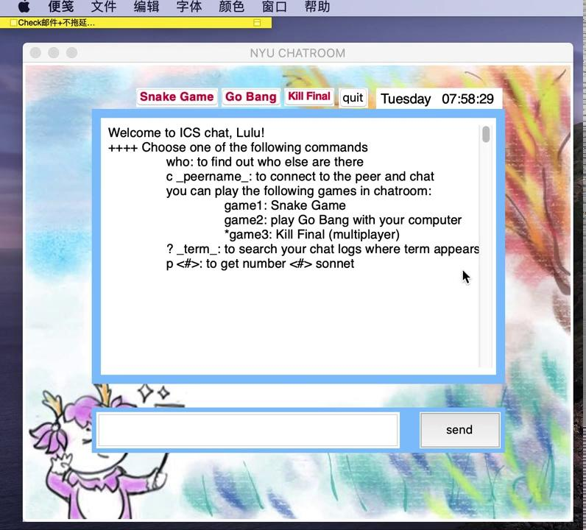
Verification
Code
Demo

Slide 5
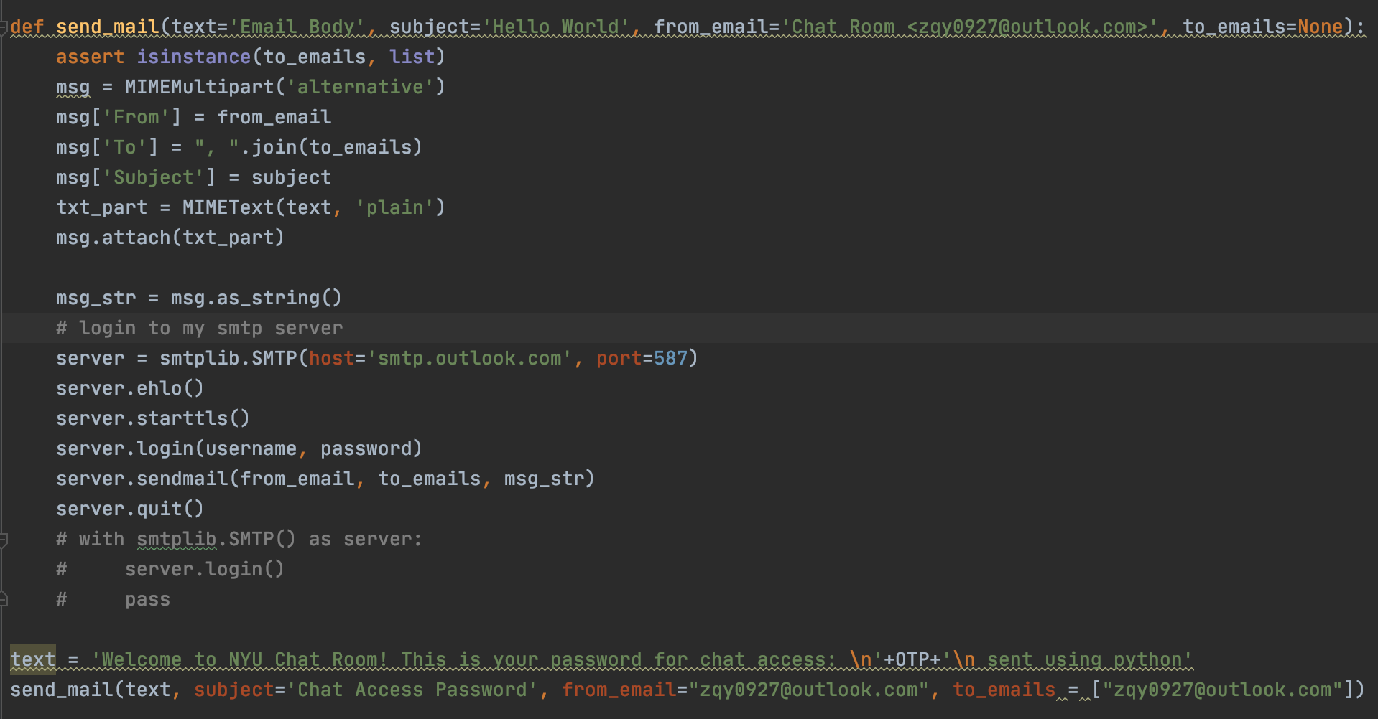
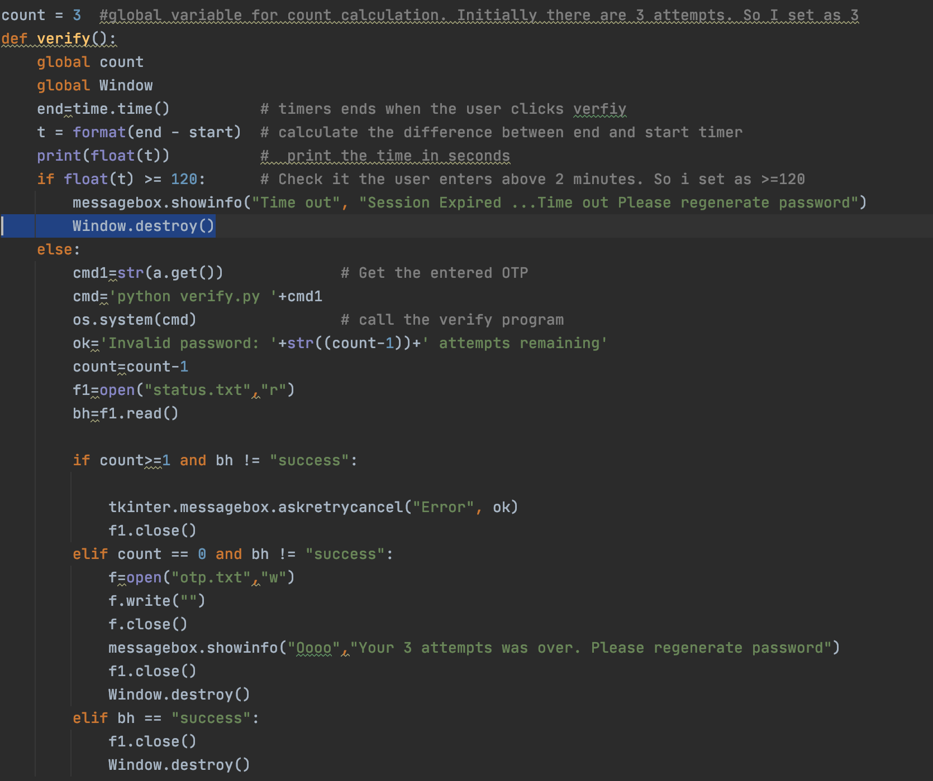
python email verify

Slide 6
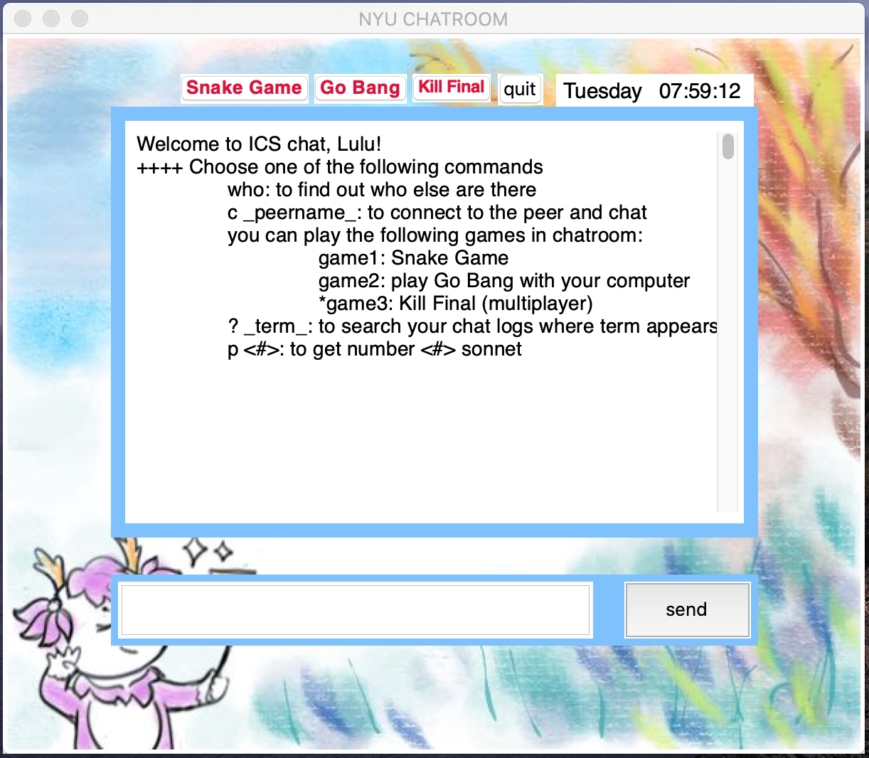
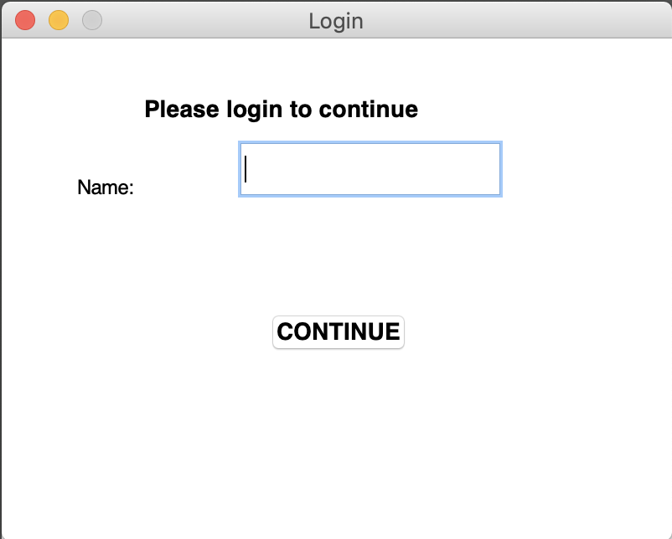
GUI

Slide 7
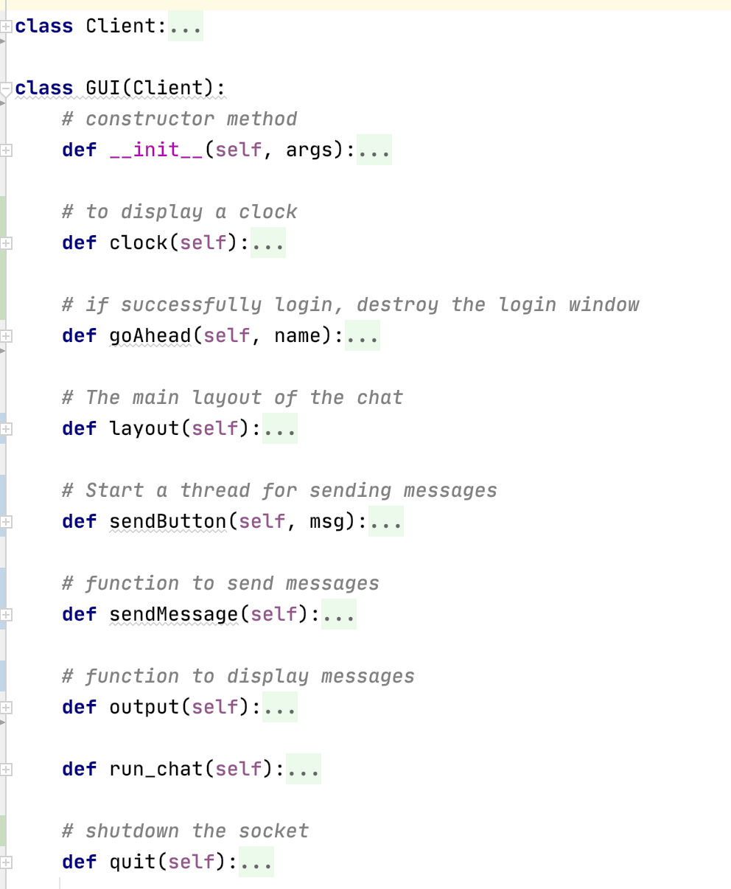

GUI
A box to display messages
An entry box to send messages
some buttons:
games
quit
time

Slide 8
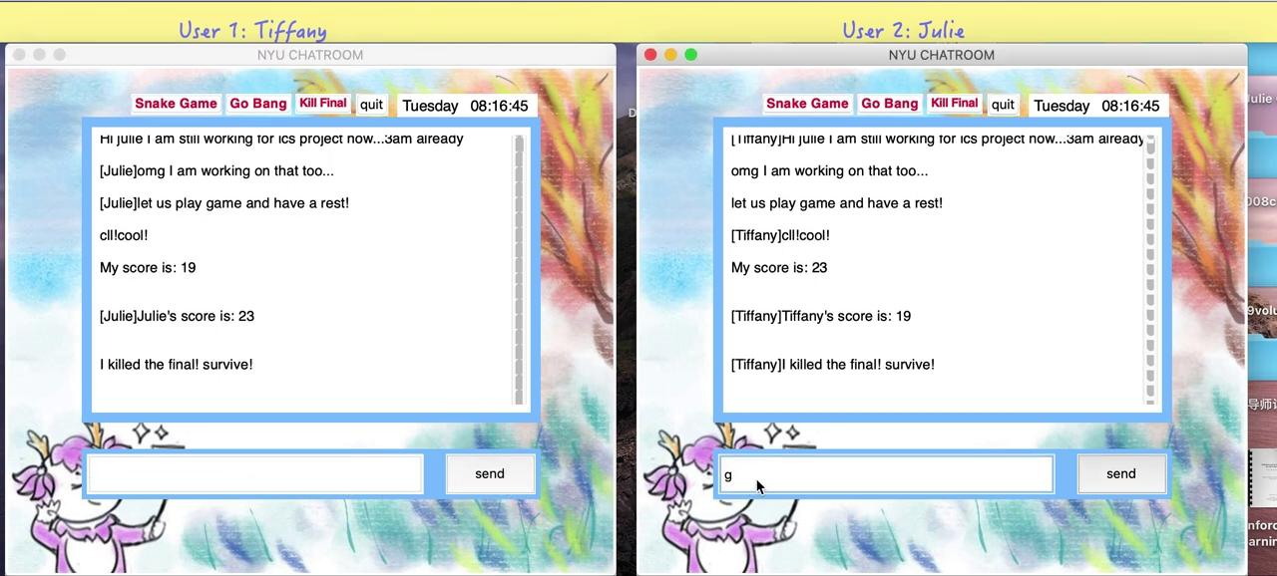

Slide 9

Snake Game
Video Demo
movement with .turtle
extend body length using list
changing color
update score
background music

Slide 10
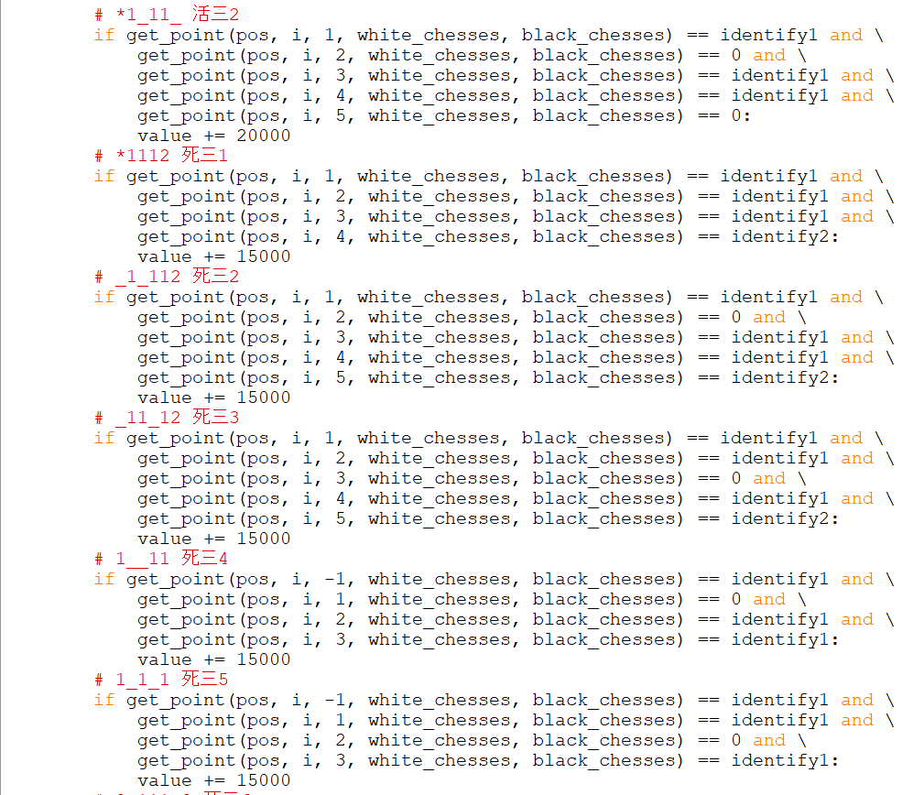
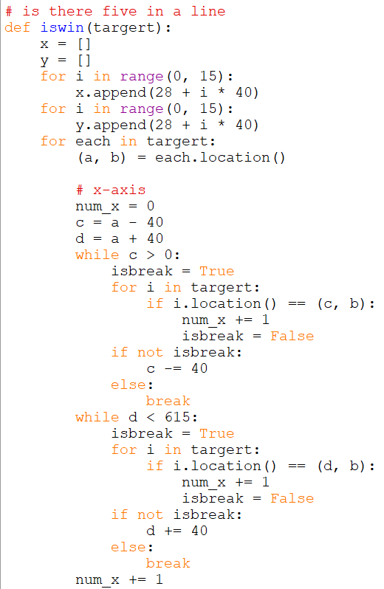
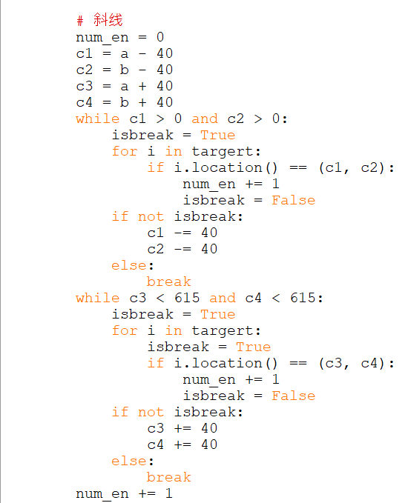
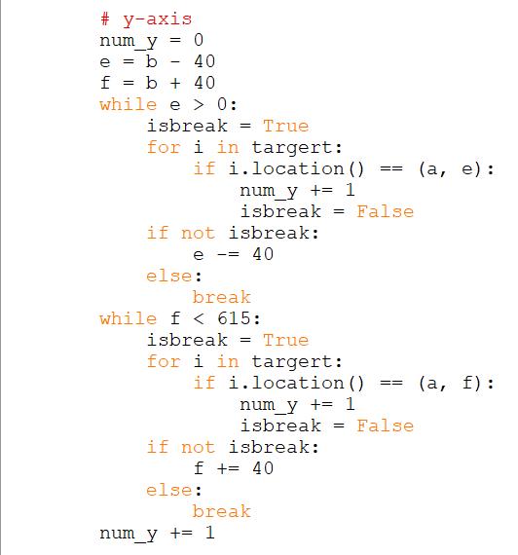
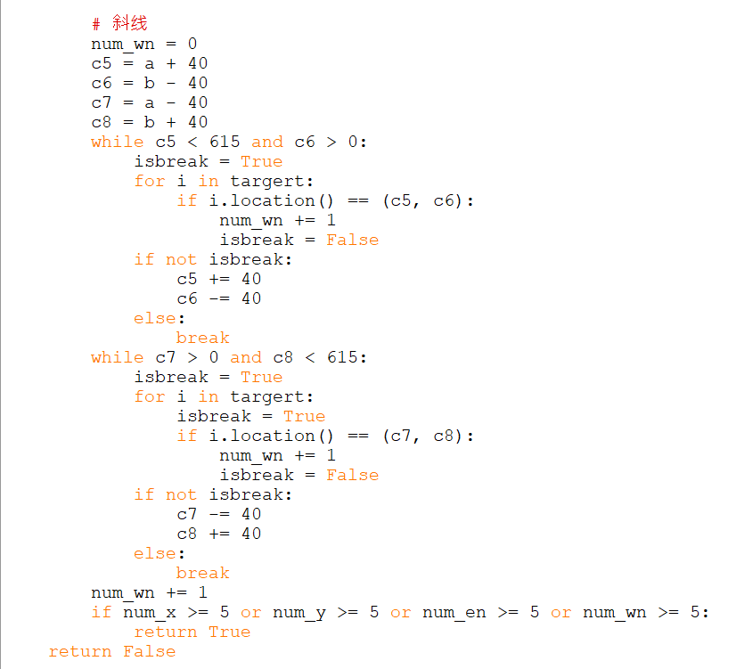
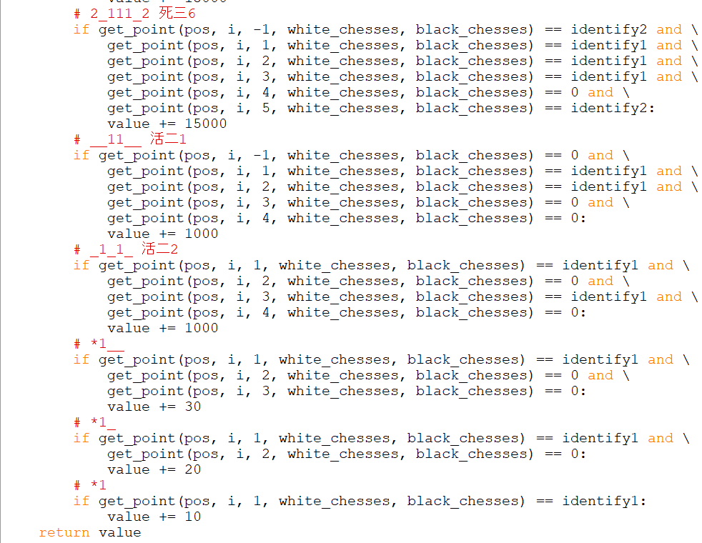
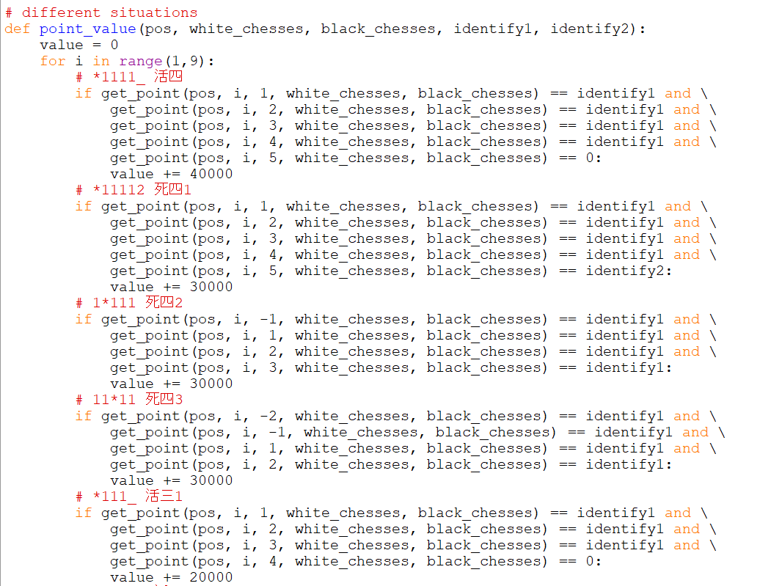
Gobang Game
Whether there are five chessmen in a line
Initialize the chessboard and chessmen
Background music and click buttons
Different situations in Gobang

Slide 11
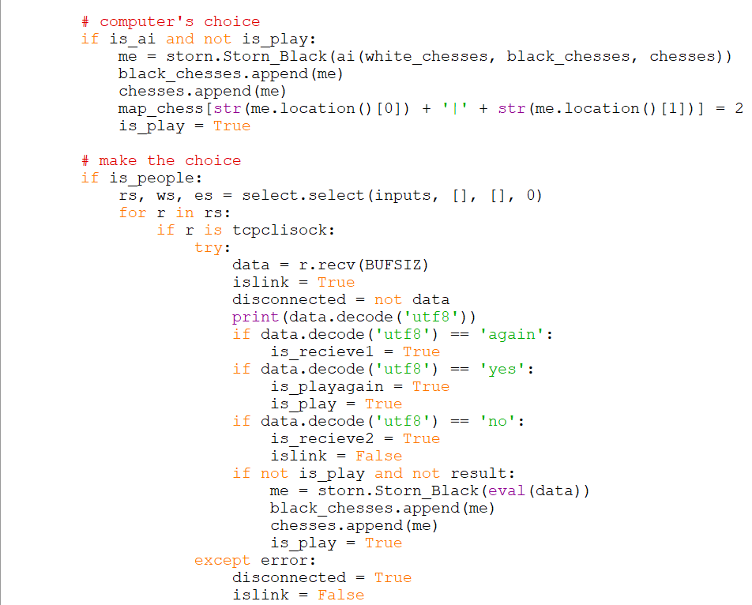
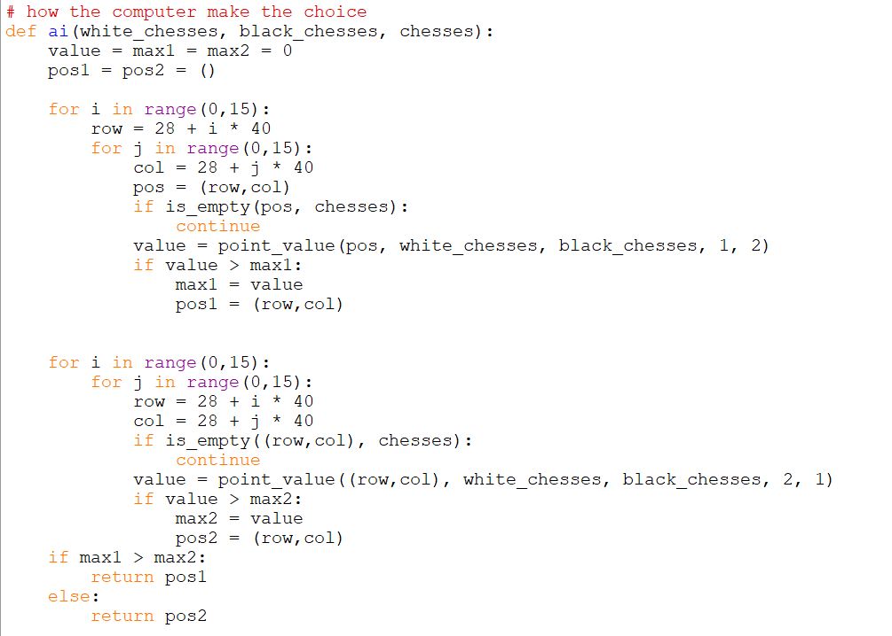
Gobang Game
Play with Others
(is_people)
Ask for IP address
Play with Computers (is_ai)
Computer decide where to put the chess

Slide 12
Gobang Game
Video Demo

Slide 13
Kill Final Game
Video Demo
use socket & server to share grades
handmade graph

Slide 14
Thank for your watching !
Qainyu Zhu
Sihan Liu
Xiaoyan Tang
Good luck for all of you with your finals~~

